Slide 1

Setting up a machine with R using a Jupyter interface
v1.0

Slide 2
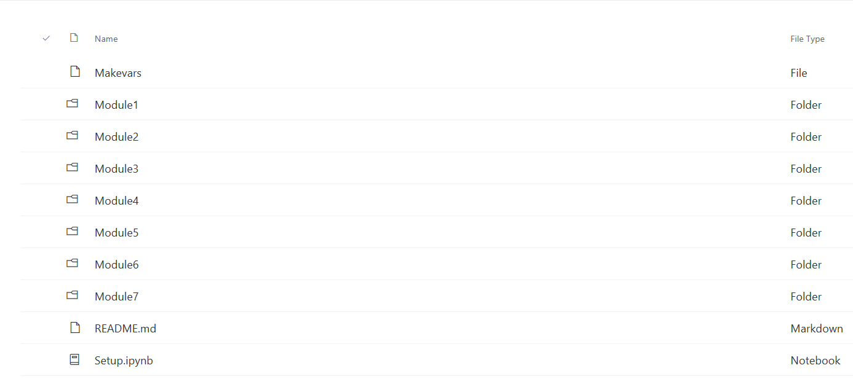
Overview
This requires you to be able to download opensource executable files on your machine.
Install Anaconda from https://www.anaconda.com/distribution/
2) Run it
3) From Applications on [ base (root) ] display select: Install Rstudio (Anaconda Navigator view). Note: It will come up with a message cannot install on base do you want to install it on Rstudio – click yes.
4) Set the kernel in Anaconda to R by following instructions “Setting the kernel to R”on the next slide
5) From Applications on [ rstudio ] display select: Install Jupyter Notebook
6) Download the course documents from https://github.com/MicrosoftLearning/Principles - of-Machine-Learning-R to the directory on your computer: c:\Users\*USERNAME*\Course Docs (make a new folder with this name) Note: *USERNAME* is the name of your user subdirectory e.g. Jane.Doe
7) From Applications on [ rstudio ] launch Jupyter Notebook
You can also launch it directly from the Windows menu as Jupyter Notebook (r) (or create a desktop shortcut).
8) Click on the folder Course Docs, select the Module you want, then click on the .ipynb file to run the module.

Slide 3
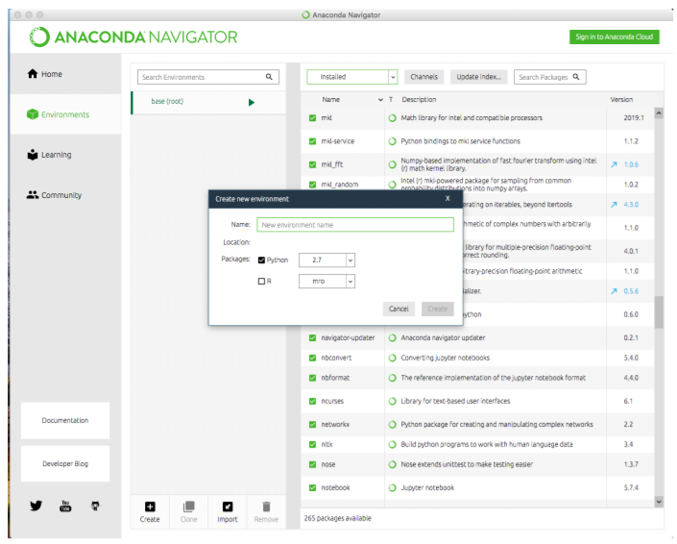
Setting the kernel to R
1) Start the Navigator.
2) Select Environments to create an new environment.
3) Name the environment ‘r’, select Python 3.7 and R. Select r from the dropdown menu. Click Create.
If you get the message 'Could not find a kernel matching R.’ Please select a kernel: Click on: Kernel ->select ->r-tutorial.
(To stop it popping up again for that module click on the box near right top that says 'not trusted' and change it to 'trusted')

Slide 4
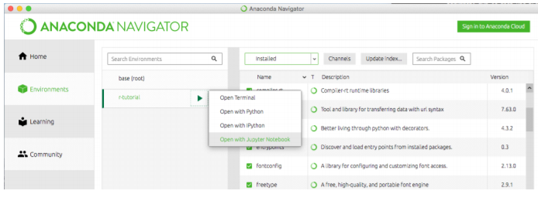
Jupyter Interface view - R
1) Open the environment with the R package using the Open with Jupyter Notebook option.

Slide 5
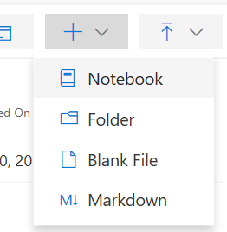
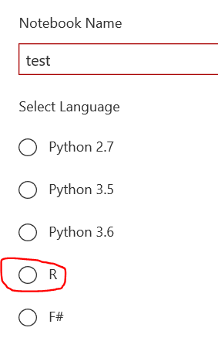
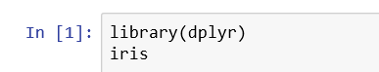
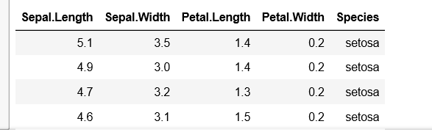
Ipnyb example (1)
In the project imported from GitHub, create a new notebook in R: in the Jupyter Notebook menu, select New, then select R.
We will use “dplyr” to read and manipulate Fisher’s Iris multivariate data set in this tutorial.
In the “test” notebook, copy and paste the following code into the cell:
library(dplyr) iris
Click on Run or press CTRL+Enter
The iris data table is displayed.

Slide 6
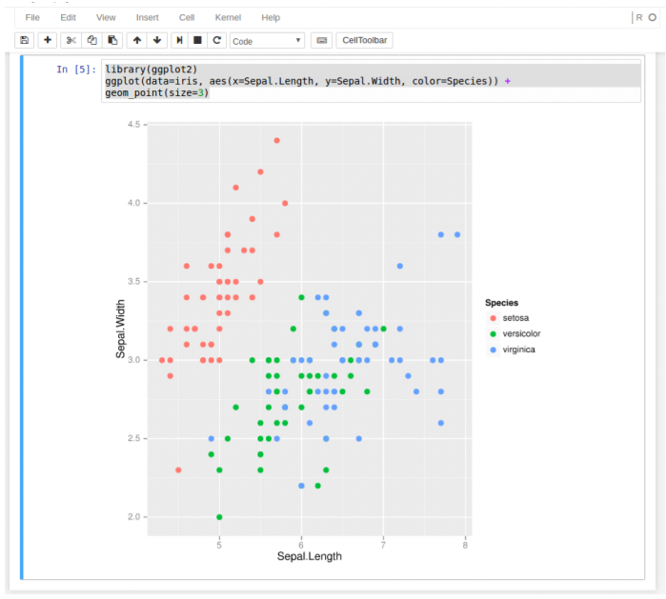
Ipnyb example (2)
Using ggplot, we can create a scatter plot comparing sepal length and width of three iris species. Click + to open a second cell, then copy and paste the following code into the second cell:
library(ggplot2)
ggplot(data=iris, aes(x=Sepal.Length, y=Sepal.Width, color=Species)) + geom_point(size=3)
Click on Run or press CTRL+Enter

Slide 7
Further resources
Anaconda: Anaconda Developer Blog (https://www.anaconda.com/blog/) Using R with Anaconda (https://docs.anaconda.com/anaconda/user-guide/tasks/using-r-language/)
R: Microsoft Learning Site @Github: (https://github.com/MicrosoftLearning/)
R Cheat Sheets: https://www.rstudio.com/resources/cheatsheets/

